Slide 1
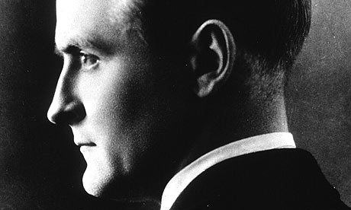
F Scott Fitzgerald… (Don’t call him frances!!)

Slide 2
No lexus for you!
Fitzgerald was born to a wealthy family in St Paul
His father lost his job and the family didn’t want anyone to know
Spent the rest of his childhood pretending he was rich

Slide 3
Poor little scottie!!
Fitzgerald was a good writer- went to Yale University on scholarship
Again- poorest kid at a really rich school
Dropped out of college when he had to do “work study”

Slide 4
The first victim…
Fitzgerald falls in love at age twenty with the rich and lovely Genevra
He stalks her, sending hundreds of letters-
“she marries someone with more $$

Slide 5
Next victim… the lovely Zelda
After Genevra marries a richer man, Scott enlists in the army
At a party, in uniform, he meets Zelda
She is extremely rich, extremely spoiled and rather promiscuous

Slide 6
The perfect date
In a newspaper article, she was quoted as saying that she cared about only two things: “Boys and swimming”
Scott would later describe their behavior as ”Pure sexual recklessness”

Slide 7
Bad girls have more fun…
She loved attention and looked for trouble—whether by learning the African-American dance known as the Charleston, or by wearing a tight, flesh-colored bathing suit to fuel rumors that she swam nude

Slide 8
How do you like me now?!
She promises to marry him, then backs out when she finds out he actually has no money
He publishes his first novel, This Side of Eden, and she marries him

Slide 9
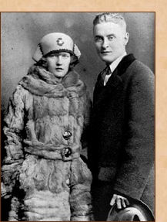
Love you, hate your coat
Young, attractive(?) and wild, they become icons of the age
They love each other but cheat continuously
Arrested for public drunkenness, lewd behavior, bitter fights

Slide 10
No turnitin.com in 1920!
” Mr. Fitzgerald -- I believe that is how he spells his name -- seems to believe that plagiarism begins at home.”
Fought when he stole diary, used real dialogue for his novels

Slide 11
Mother of the year
In 1921, she gives birth to Frances "Scottie" Fitzgerald.
As she emerged from the anesthesia, Scott recorded Zelda saying, "Oh, God, goofo, I'm drunk. Mark Twain. Isn't she smart—she has the hiccups. I hope its beautiful and a fool—a beautiful little fool"

Slide 12
Julia childs? Not so much
When asked to contribute to Favorite Recipes of Famous Women she wrote: "See if there is any bacon, and if there is ask the cook which pan to fry it in. Then ask if there are any eggs, and if so try and persuade the cook to poach two of them. It is better not to attempt toast, as it burns very easily. Also, in the case of bacon do not turn the fire too high, or you will have to get out of the house for a week. Serve preferably on china plates, though gold or wood will do if handy”

Slide 13
No man friends for scottie!!!
One famous fight occurred when Zelda told Scott that their sex life had declined because he was "a fairy" and accused him of having a homosexual affair with Hemingway. There is no evidence that either was homosexual, but Scott nonetheless decided to sleep with a prostitute to prove his masculinity. Zelda found condoms that he had purchased before any encounter occurred, and a bitter fight ensued.
She later threw herself down a flight of marble stairs at a party because she believed that he was ignoring her.

Slide 14
And the winner is???
They remained married but Scottie eventually locked Zelda into an insane asylum
Asylum burned, killing Zelda
Fitzgerald died, a broke alcoholic, at age 44

Slide 15
Moral(S) of the story??
Don’t marry rich, ignorant spoiled girls with bizarre names
And/0r
Don’t marry obsessive stalker guys who drink too much and lock you in insane asylums

Slide 16
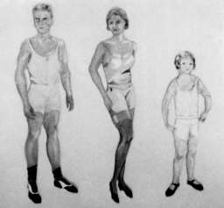
Weird side note….
Before her death, Zelda created a line of paper dolls
This one is called “Family in Underwear”
Look familiar?

