Slide 1
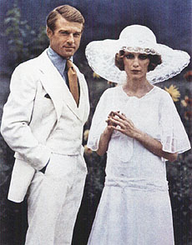
The Jazz Age:
The 1920’s in The Great Gatsby

Slide 2

Gatsby:
Novel of the Jazz Age
Written by F. Scott Fitzgerald
Focuses on the ultra wealthy
Reflects the wildness and excess of the era

Slide 3
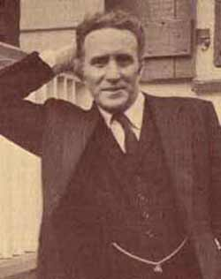
F Scott Fitzgerald
http://janleighton.com/images/1280/F_Scott_Fitzgerald.jpg
Life parallels the story- poor to rich
Raised in St. Paul
Zelda married him only when he was rich
Moved among the wealthy- saw the purposelessness and immorality of the rich

Slide 4
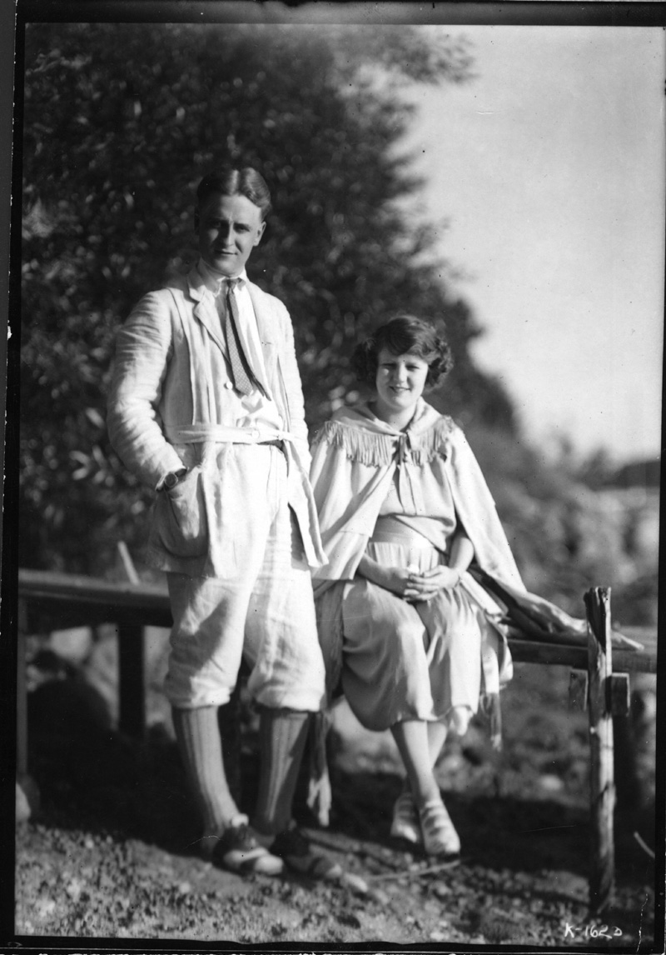
Literary Genre
Falls into the category of literary modernism: pessimistic view of mankind
Considered a BILDUNGSROMAN- the story of a boy becoming a man
Nick celebrates a birthday- learns a vital truth of life:
Being rich can make people jerks

Slide 5

American Dream is born
American Dream first written about by Horatio Alger
Wrote first “rags to riches” stories- poor boy works hard and becomes successful
135 dime novels: Tattered Tom

Slide 6
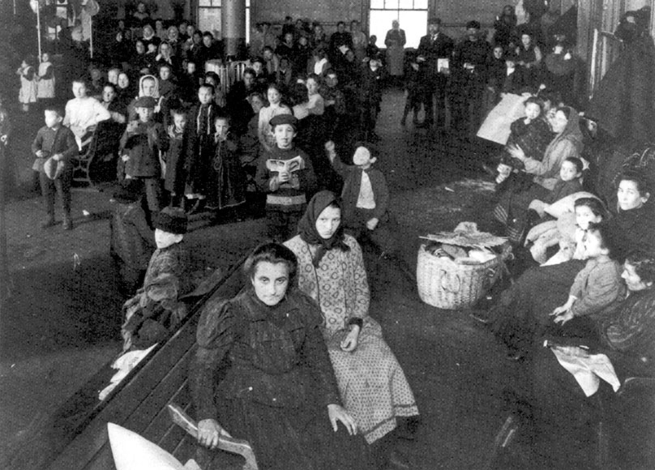
Why AMERICAN dream?
Ethic of hard work, survival
Immigrants arrived in huge numbers from Europe
Not possible in many other countries : No caste system

Slide 7
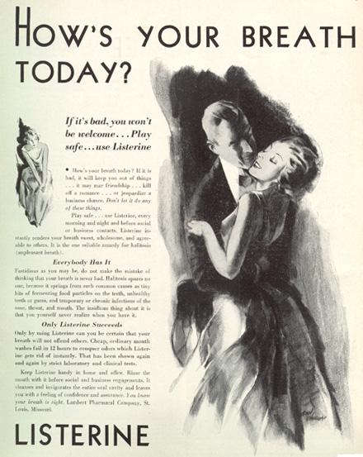
Why 1920’s?
Cultural Forces
Advertising begins
Consumer Confidence high: Post War Bliss
40 hour work week: Life seems good, more free time
Credit: Makes huge purchases possible

Slide 8
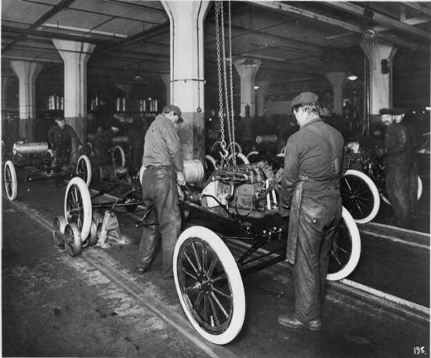
Henry Ford: A Genius
Henry Ford creates a middle class for the first time
Pays $5.00/day 8 hour day
For the first time, factory workers can afford the item that they make! ¾ own cars

Slide 9
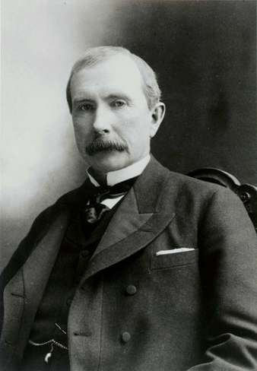
Icons of Industry and Business
Rockefeller
JC Penney
Firestone
Sears and Roebuck
Carnegie

Slide 10
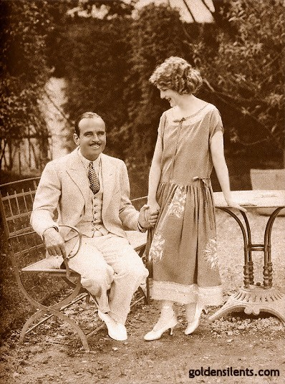
Birth of the
“Nouveau Riche”
Means (in French) new wealth
Implications:
Culturally inferior
Lacking in good taste
Stupid/ uneducated

Slide 11
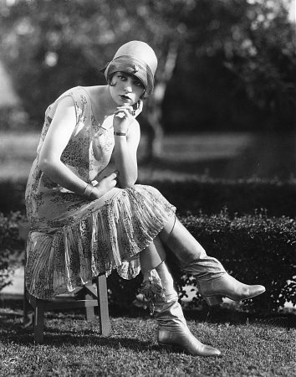
Wild Women
Flappers are created
Exemplify the paradigm shift of the age
Wild, drinking, smoking, sexually promiscuous
Also capable of achieving success (through sports, )

Slide 12
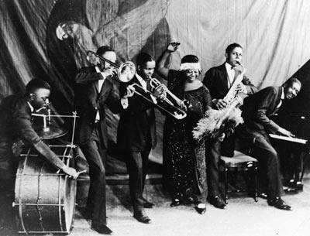
Wild Music
Jazz Music
Influenced by African American and Cajun music
Creation of Jazz Clubs
Parents hated it! “Stay away from Jazz and liquor”

Slide 13
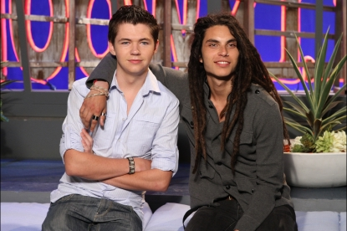
American Dream in 2009?
American Idol
Who Wants to Be a Millionaire
Internet Businesses

Slide 14
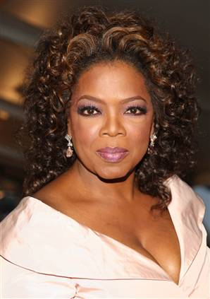
Possible?
Oprah Winfrey
Sam Walton
Ray Croc
Bill Gates
Chuck Norris

Slide 15
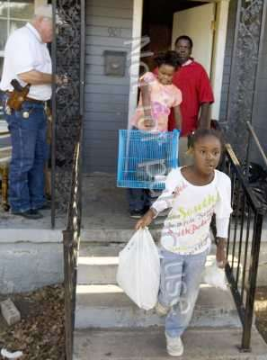
Probable?
Foreclosures at a record level
Bankruptcies at a record level
Savings in the negative numbers
Millions without health insurance
Food shelves- record use

