Slide 1
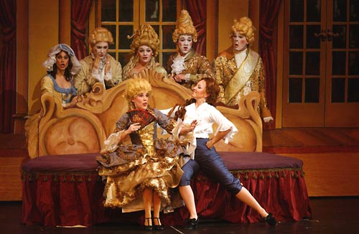
Opera
Seven Habits of Highly Effective Operas

Slide 2
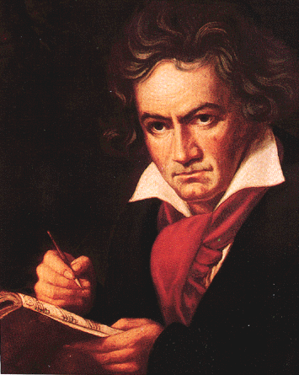
They Come from the Heart
Beethoven’s Fidelo: Break free from the bonds of oppression
Beethoven struggling with deafness
La Boheme: Puccini’s Life

Slide 3
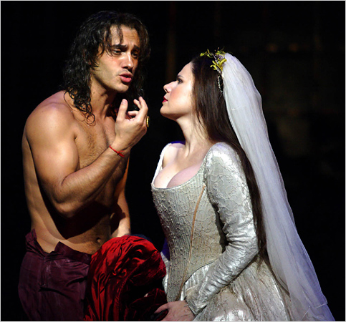
Primal Human Emotion
Lust
Greed
Anger
Pride
Envy
Singing is the best way to express these feelings (rap, punk, rock)

Slide 4
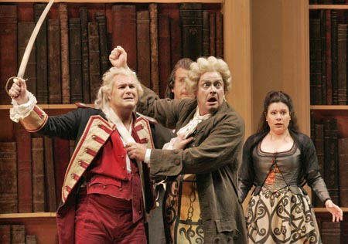
Good Stories
Lots of sex and violence
Lots of variety within each story

Slide 5
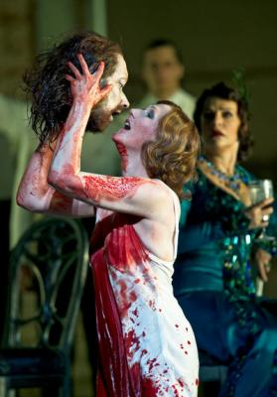
Cool Sets, Costumes, and Special Effects
Set in hell, heaven, underwater, exotic places
Included elephants, animals, flying, disappearing, etc.

Slide 6
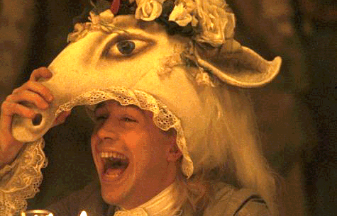
Creative and Original
The best ones got their writers in trouble

Slide 7
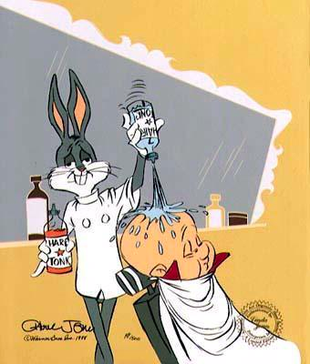
Catchy Tunes
Bugs Bunny: Rabbit of Seville
Commercials: “Welcome to Winter…”
Answering Machine “Nobody’s Home!”

Slide 8
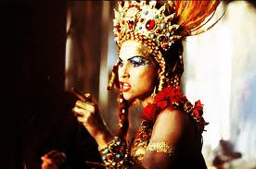
Flamboyant Stars
Huge, loud, temperamental, charismatic
Audience carried Verdi home on their shoulders after opening night.

