Slide 1
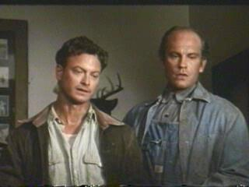
CHARACTERIZATION

Slide 2
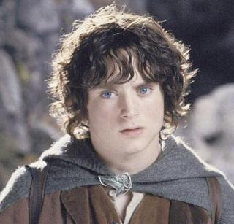
Protagonist
“One who plays the first part”
Often the hero but not necessarily a good guy
The person around whom the events of the plot revolve

Slide 3
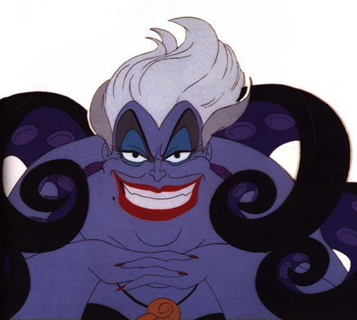
Antagonist
The principal opponent of the protagonist
Creates obstacles that the protagonist must overcome
Can be more than one in a piece of lit

Slide 4
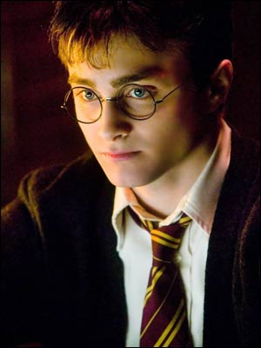
Dynamic Character
A character who changes significantly over the course of the story
Often ends up sadder but wiser

Slide 5
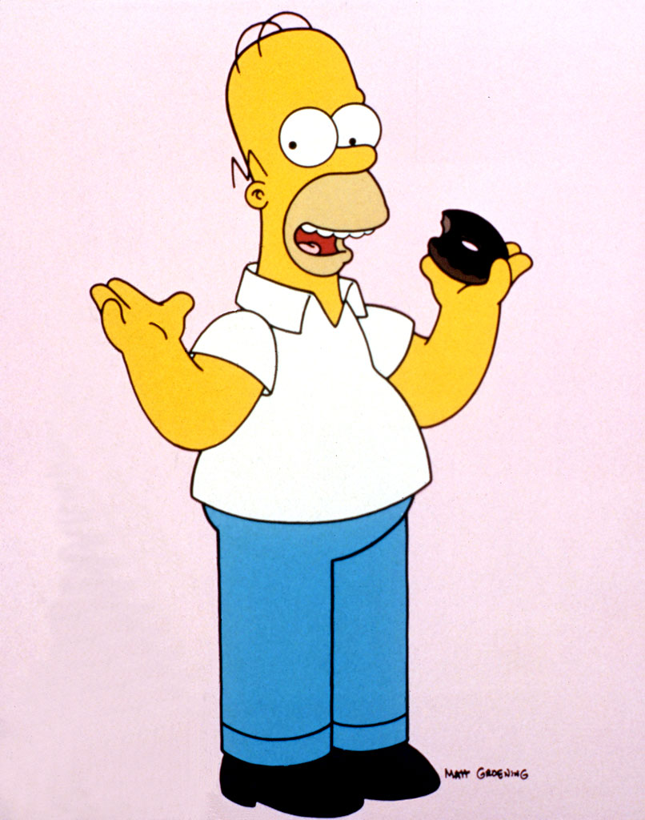
Static Character
A character who does not significantly change over the course of the story

Slide 6
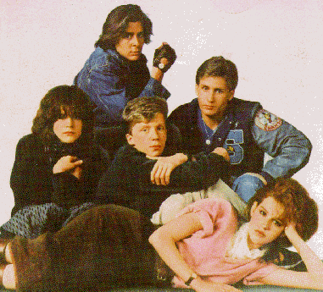
Stock Character
Characters who have become conventional or stereotypical due to repeated use in stories
Immediately recognizable to readers
mad scientist
Femme fatale
Geeky kid w/glasses

Slide 7
Foil
Any character whose personal qualities contrast with another character
Qualities of one emphasize opposite qualities of the other
Iron Man and Pepper
JWOW and Snookie
Michael and Trish

Slide 8
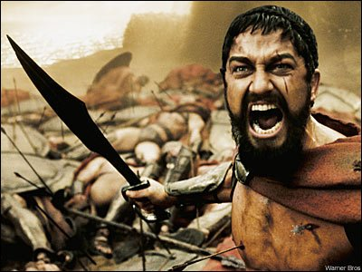
External Conflict
Conflict that exists between a person and an external force
Man v. Man
Man v. Nature
Man v. Society
Man v. Destiny

Slide 9
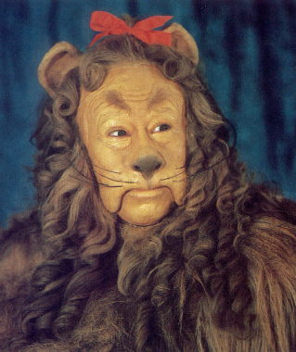
Internal Conflict
Conflict that takes place within a character
Mental Illness
Addiction
Finding courage
Questions of conscience and/or morality

