Slide 1
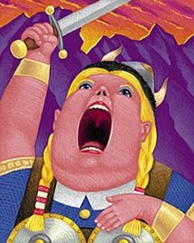
Opera Singers and their Equipment

Slide 2
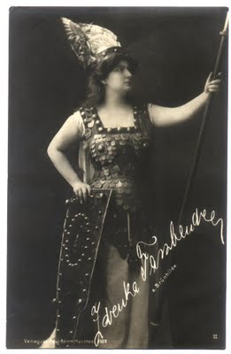
Stereotypes
“It’s not over ‘til the FAT LADY sings”
Huge woman with Vikings helmet, braids, metal chestplate
Actually only The Ring used this look

Slide 3
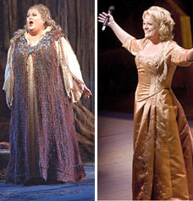
Do They Have To Be SO BIG?
Yes and no
Need big voices- no microphones over full orchestra
Big lungs come in big packages
Big appetite for life!

Slide 4
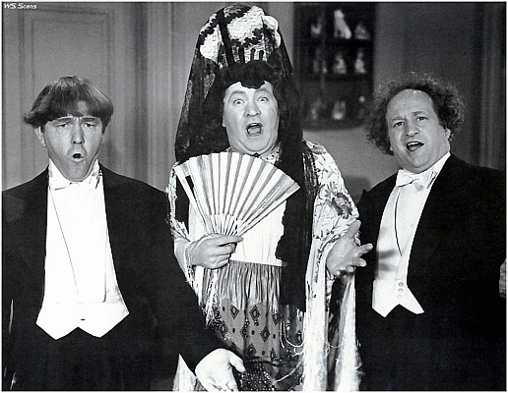
Opera Voices
Soprano
Mezzo Soprano
Contralto
Tenor
Baritone
Bass

Slide 5
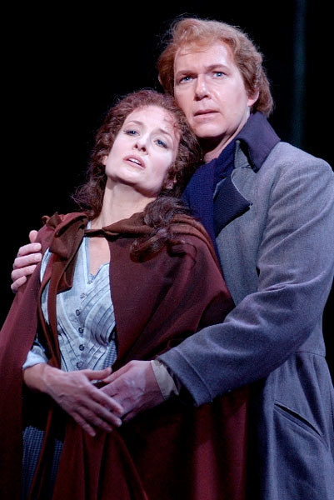
FACH??
Fach= compartment
Two fachs
Lyric= sweet
Dramatic- Steely, powerful
Lyric= heroines
Dramatic= villains

Slide 6
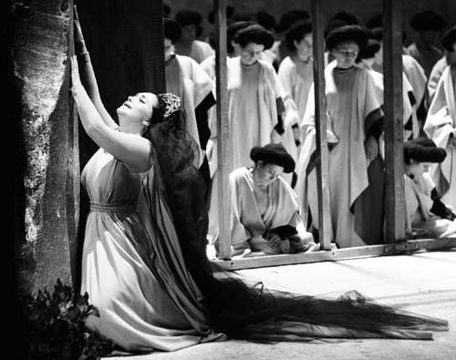
Voice Determines Role
Soprano=heroine= Paid the most!!
Mezzos= Tramps, Vamps and Witches
Contraltos= maids, mothers, grandmothers
(replaced castrati)

Slide 7
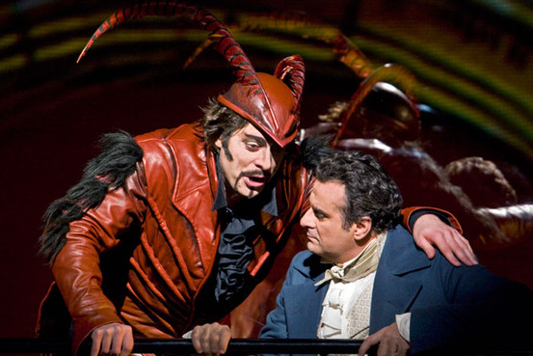
Same for men!
Highest voices paid the most
Tenor= male lead
Baritones= wise guy, comic relief, bad guy
Bass= grandfather, devil

Slide 8
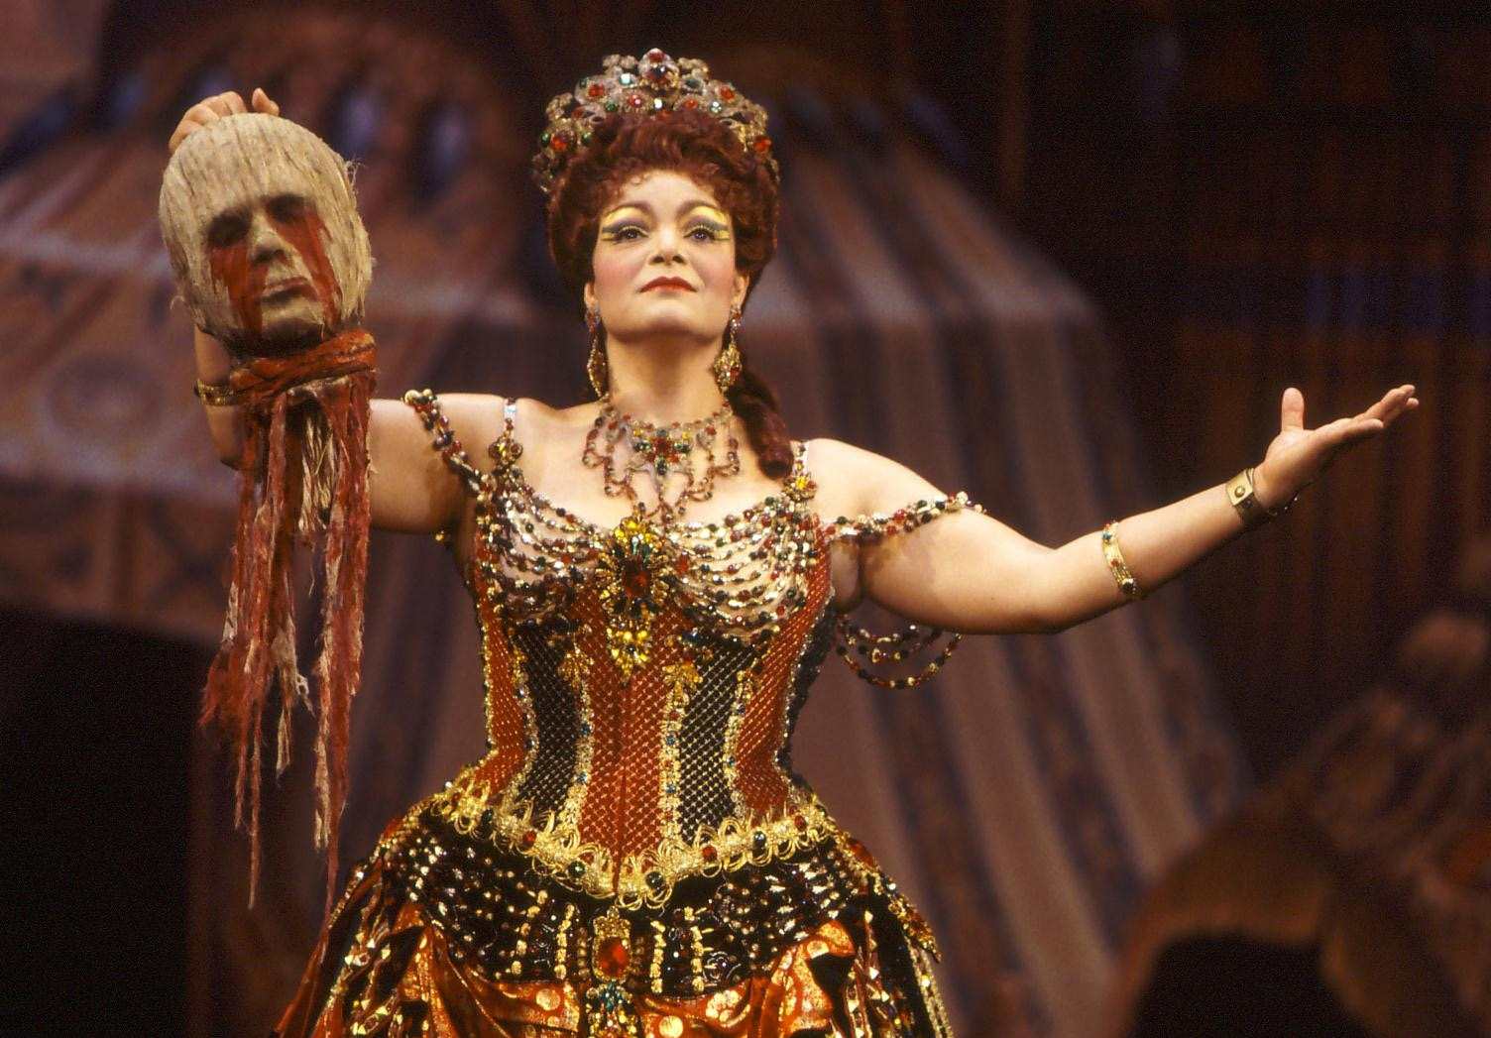
Beware the Diva!
Prima Donna= literally means “first lady”
Reputation for crazy, obsessive behavior
No dairy or acidic food
Sing 10-12 hours/day
Fight for spotlight

Slide 9
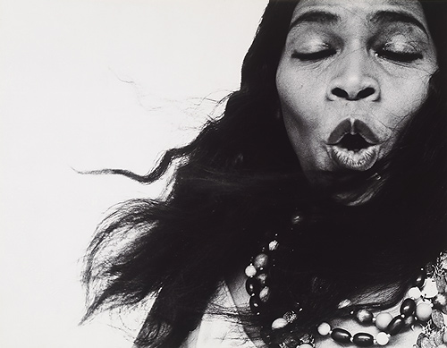
Most famous woman opera singer
Marian Anderson
Not allowed to sing at Constitution Hall in DC
Eleanor Roosevelt intervened
First black woman to sing at the New York Metropolitan Opera

Slide 10
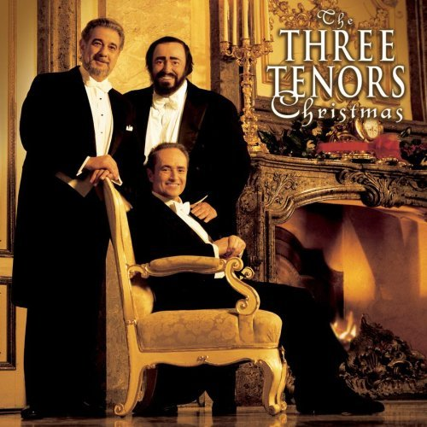
The Three Tenors
Lucianno Pavarotti
Placido Domingo
Jose Carreras

Slide 11
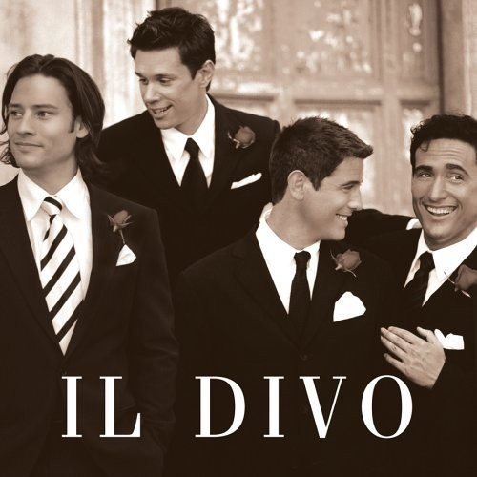
Il Divo
Formed by Simon of American Idol
Multinational- Italian, Swiss, Spanish, American
Hot Hot Hot!

Slide 12
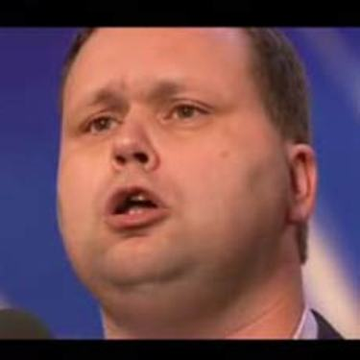
Paul Potts!!
Newest opera superstar
Cell phone salesman
“Discovered” on American Idol

