Slide 1
Phantom of the Opera

Slide 2
Gaston Leroux (say it like your nose is plugged)
Journalist/ newspaper reporter
Wife angry about late nights at the paper
Started writing serial mysteries

Slide 3
A Legend is born
Finished Le Fantome de l’Opera in 1910
First version written in French
Sales were poor

Slide 4
The Paris Opera House
Called the “Palais Garnier” (1875)
Seats 2200 people
17 stories high
New innovations- gas lighting
Layers of cellars, trap doors, secret passageways

Slide 5
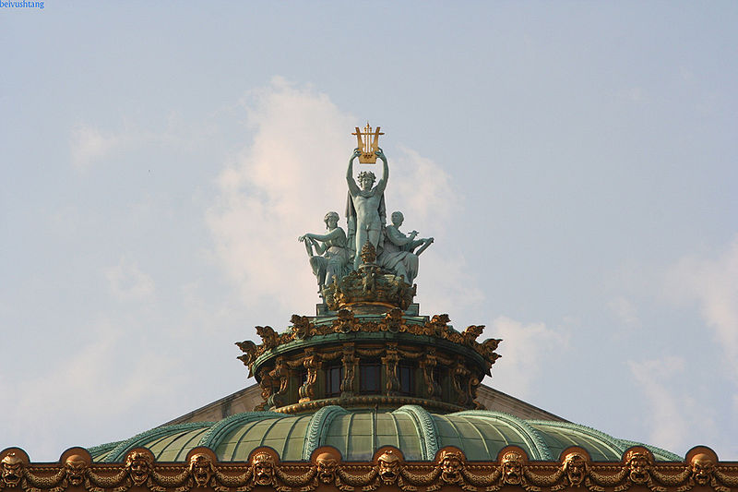
Beautiful architecture

Slide 6
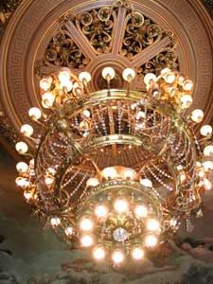
The Chandelier falls!!

Slide 7
Joseph (John) Merrick
Disease began to show at age 3
Mother died- father remarried/ stepmother threw him out at 12 yrs
Forced to work for money in a freak show
Saved by Dr Frederick Treves
Died at age 28

Slide 8
"Tis true my form is something odd, But blaming me is blaming God. Could I create myself anew, I would not fail in pleasing you.
If I could reach from pole to pole, Or grasp the ocean with a span, I would be measured by the soul, The mind's the standard of the man."

Slide 9
Novel: era of science and reason
Written during a period of discovery and science
Nothing is magical or supernatural
Epilogue= “Loose Ends Tied Up”
Fear counteracted with explanation

Slide 10
A Reflection of the Time
Novel reflects Paris society
Every level of society seen-
Lowest= rat catchers
Highest= nobility,count, vicomte

Slide 11
Wealthy/ nobility= boxes

Slide 12
Beauty is skin deep
Theme of “masquerade” runs through the story
People are not be whom they appear to be
Rich and poor intermix-classless society

Slide 13
Ballet School
Girls trying to achieve fame live in famous Paris Ballet school/dormitories

Slide 14
Phantom Becomes a Film
Phantom is made into a silent movie in 1925
Lon Cheney portrays first Phantom on screen
Uses wires and other contraptions to disfigure his face

Slide 15
Claude Rains: 1943

Slide 16
Herbert Lom: 1962

Slide 17
It Begins Again…
Broadway version opens in 1986
Written by Andrew Lloyd Webber
Most successful Broadway play of all time
Starring Michael Crawford

Slide 18
The real Christine!
Webber writes the part of “Christine” to woo Sarah Brightman, his “angel of music.”
They eventually get married

Slide 19
Yummmmmmmm
Movie version released in 2004 w/ Gerard Butler
Also directed by Andrew L. Webber
Wanted to appeal to a younger audience
Less operatic than other versions

Slide 20
Call me Mrs. Butler!!
Play/ movie highlights
Romance
Mystery
Sensuality
Phantom is a dark hero- frightening and appealing at the same time
(like Batman!)

Slide 21
Phantom Rocks
Phantom is the most successful entertainment event of all time
Has grossed over 5 billion dollars (5 x that of Titanic)
All began with a mediocre book!!

