Slide 1
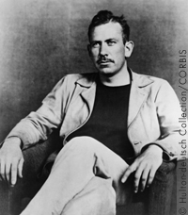
John Steinbeck: sadly normal

Slide 2

Themes of the Depression
Considered to be a writer of the “naturalist” genre
Believable, everyday reality
Poverty, prejudice, racism

Slide 3
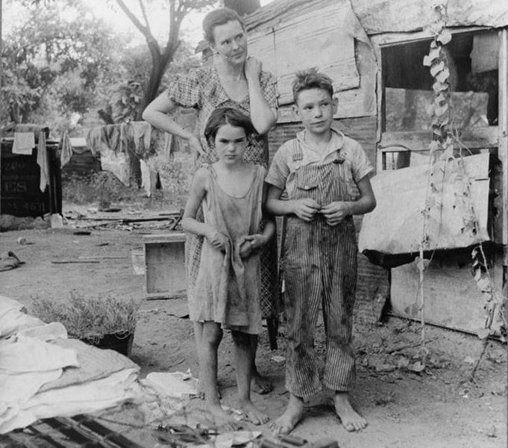
The Anti – Gatsby novel
Environment shapes fate
Choices are made to deal with a cruel world
Decent people forced into terrible situations

Slide 4
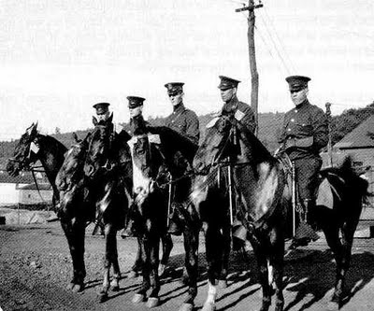
A corrupted system
Itinerant farmers/migrant workers
Working class heroes
System crushes the innocent

Slide 5
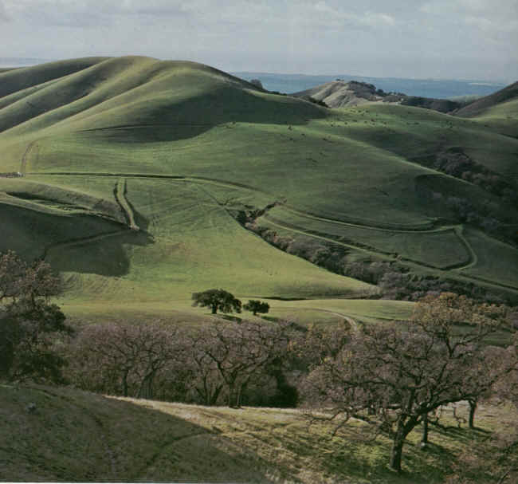
A sympathetic voice
Steinbeck lived in Salinas Valley, California
Destination for many victims of the Dust Bowl (Rte 66)
Worked on ranches with migrant help

Slide 6
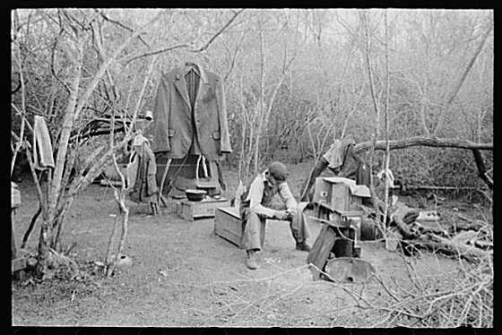
Opposed capitalism
Steinbeck opposed the system of capitalism
Felt that it kept the poor down and the wealthy on top

Slide 7
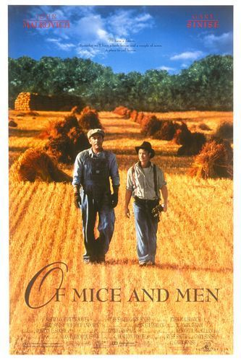
Dust Bowl Novelist
Of Mice and Men (1937)
Considered a “novella” (short novel)
Lennie and George try find the impossibile American Dream

Slide 8
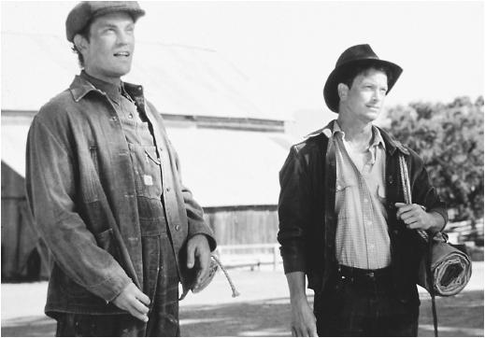
Lonlieness of Humanity
“We are lonesome animals. We spend all of our life trying to be less lonesome.”- Steinbeck

Slide 9
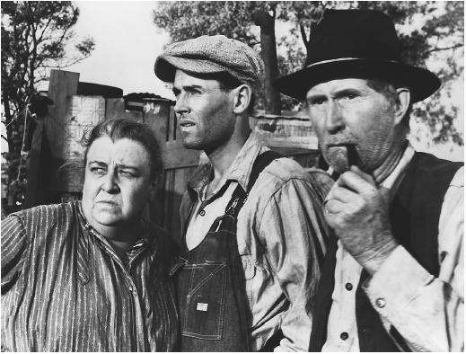
Grapes of Wrath: 1940
Joads are forced from their farm
Try (and fail) to overcome poverty
Faced with cruelty and prejudice

Slide 10

Grapes of Wrath: Mrs. Sackett will overcome!!
“Mine eyes have seen the glory of the coming of the Lord;
He is trampling out the vintage where the Grapes of Wrath are stored”

Slide 11

The Pearl
Published 1947
Also a novella
Tells the story of a fisherman and his wife whose lives are ruined when they find a valuable pearl- wealth corrupts

Slide 12

Banned Man!
Steinbeck –one of the most banned authors
Grapes of
Wrath- Anti American and pornographic
Of Mice and Men- offensive language, communist

Slide 13
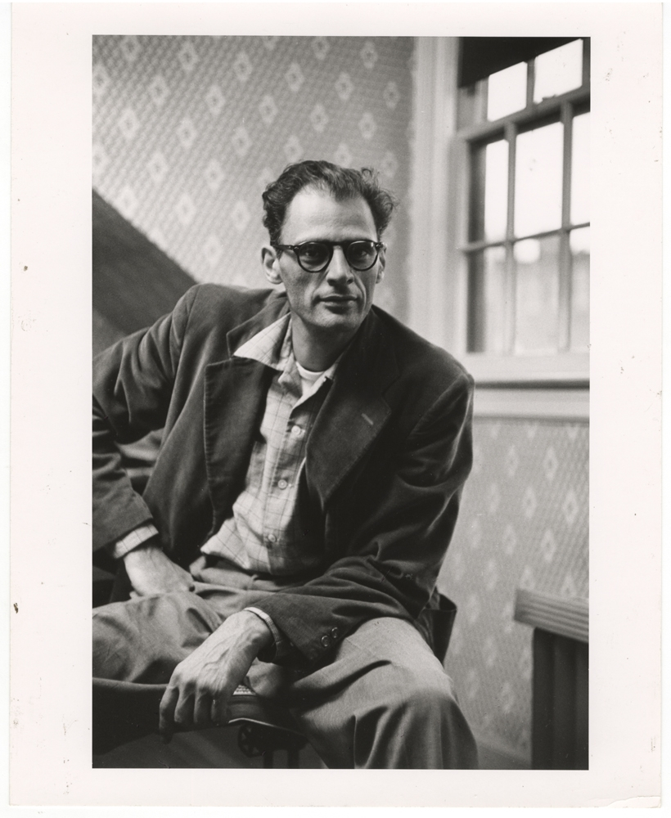
More trouble
Friends with Arthur Miller, accused of being a communist
Defended Miller at Communist hearings of the 1950’s

Slide 14
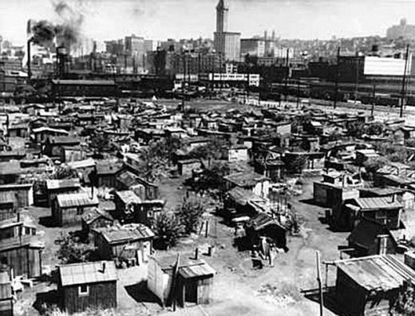
Change is possible
Poor must challenge a system that denies them sustenance and dignity
Only family and friends could provide true happiness
People must band together to help each other

Slide 15
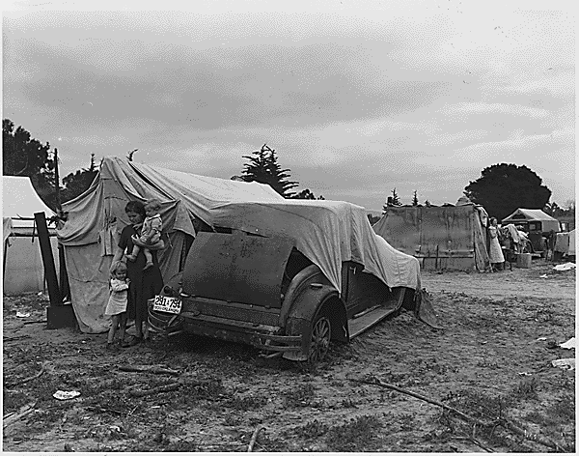
If you’re in trouble, go to the poor people. They’re the only ones that’ll help… the only ones.”

