Slide 1
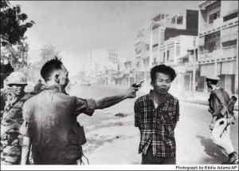
Philosophies of War
When do we kill?

Slide 2
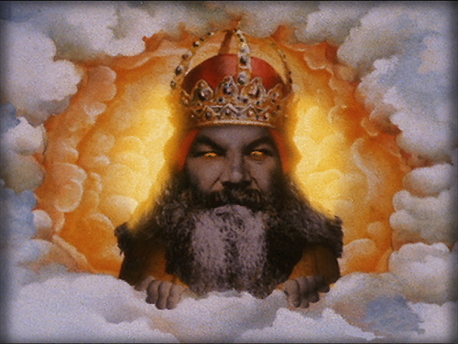
1. HOLY WAR
God commands followers to make war on those who do not believe
Common to Christians, Jews and Muslims

Slide 3
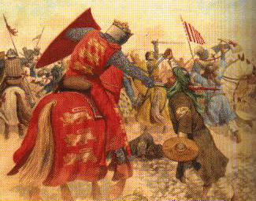
Crusades
Recover the Holy Lands from Muslim rule during the Middle Ages
Killed 2-4 million people
Deut 20:16 “Do not leave anything alive that breathes…completely destroy them”

Slide 4
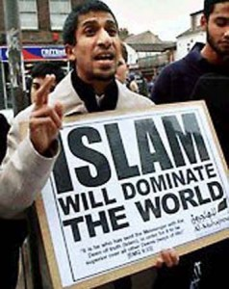
Jihad
Literally means “to struggle” or “to strive”
Holy war one of four tenents:
Moral struggle
Righteous behavior (setting a good example)
Reward= Heaven, virgins

Slide 5
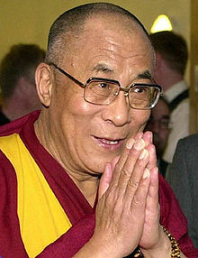
2. PACIFISM
All war is wrong
Seen in Hinduism and Buddhism
(self immolation)
“Hatred is never appeased by hatred in this world; it is appeased by love”

Slide 6
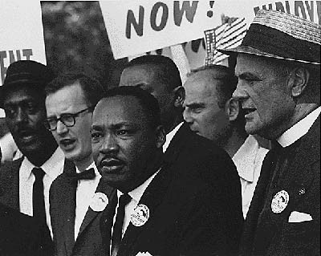
Used in non-violent resistance
Jesus: “turn the other cheek”
Gandhi: struggle against the British in India
MLK: Civil Rights struggle

Slide 7
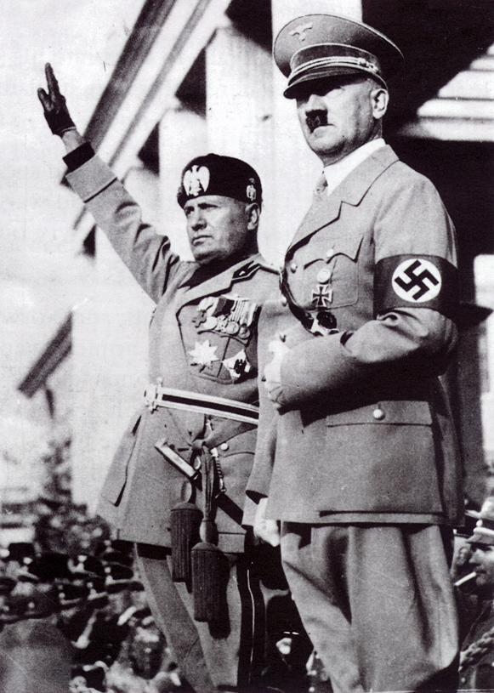
3. REALISM
Rules of morality cannot be applied to international affairs
War will always exist because people and nations are self-centered

Slide 8
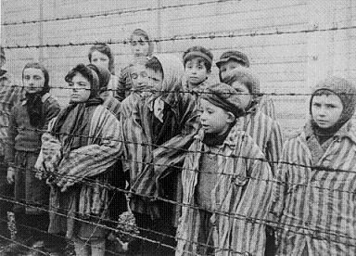
4.Just War
War only in certain justifiable situations
“Force may be used only to correct grave public evil or massive violation of the basic human rights of whole populations.”

Slide 9
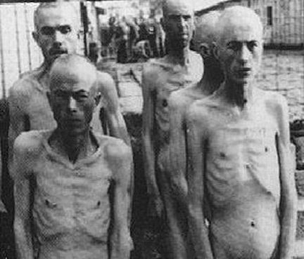
a. Just Cause
War can only be used when the cause is a noble one involving innocent human life
War cannot be used for material gain or revenge

Slide 10
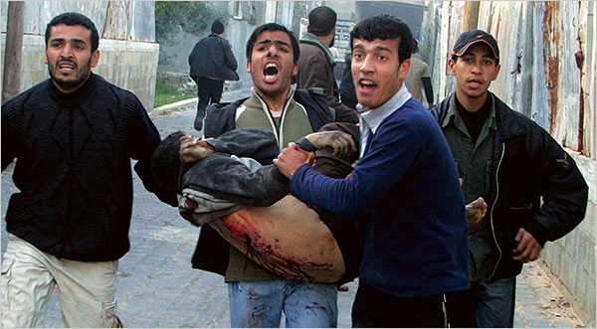
b. Comparative justice
Injustice suffered by one party must significantly outweigh that suffered by another
Although both sides may be imperfect, one must be “more right” than the other
Palestine v . Israel

Slide 11
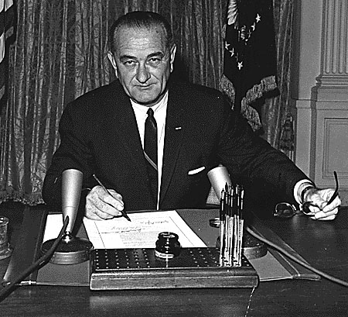
c. Due Authority
War can only be initiated by political authority within a system that allows for justice
No dictators or deceptive military tactics

Slide 12
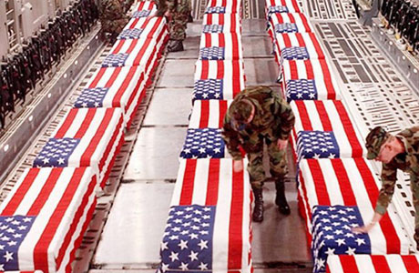
d. Probability of success
Arms may not be used in futile causes.
If there is no way to reasonably end conflict, war may not be initiated

Slide 13
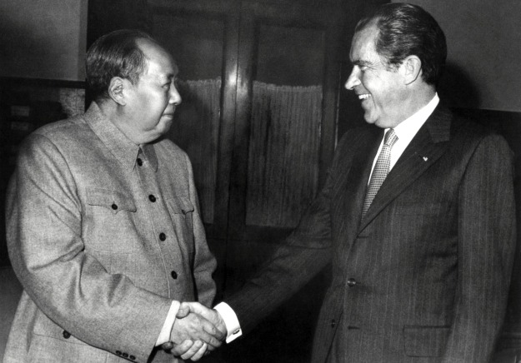
e. Last resort
Force may be used only after all peaceful alternatives have been seriously tried
Negotiations
Sanctions
Compromise

Slide 14
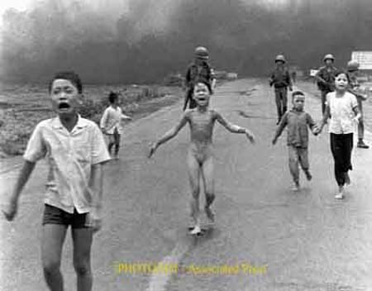
f. Proportionality
The benefits of war must outweigh expected harms and evils

Slide 15
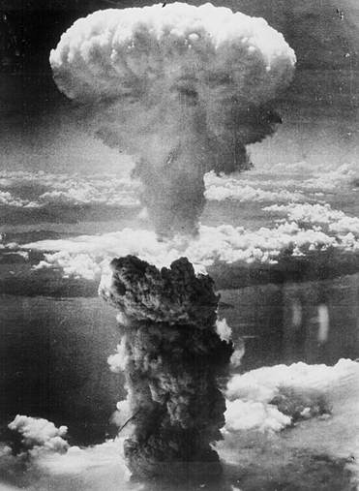
Rules during war?
Fair treatment of POW’s. Once captured, prisoners must be treated humanely
“No means malum in se”
No evil weapons can be used…mass rape, nuclear weapons, weapons that cannot be controlled

