Slide 1
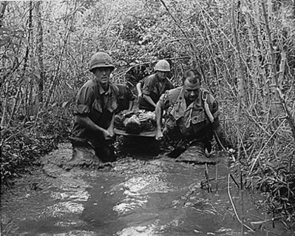
The Vietnam War: A Brief History

Slide 2
French Colonialism
France controls Vietnam from 1860 on
Vietnamese people engage in several fruitless efforts to rid themselves of France’s rule
During WWII, Japan takes control of Vietnam but leaves France in place

Slide 3
Ho Chi Minh
Declares independence from France
Creates “Declaration of Independence based on the United States’ version
Considered a hero to the Vietnamese people…

Slide 4
Vietnam looks for help
Vietnam asks FDR for help. He refuses.
Truman won’t help either….
Why? Domino Theory!

Slide 5
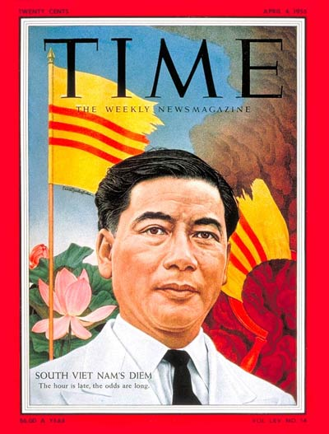
Ngi Dih Diem
Eisenhower creates a non-communist area of Vietnam
US installs Diem as president
Diem is corrupted; lies to people and causes fear between two sides of Vietnam

Slide 6
National Liberation Front of Vietnam
Ho Chi Minh leads the National Liberation Front of South Vietnam
Become known as “Viet Cong”
Rely on guerilla warfare- seen as a noble cause: many Vietnamese join

Slide 7
Gulf of Tonkin
In 1964, the US Maddox engaged in a battle with two Vietnamese ships
“ It is not simply that there is a different story as to what happened; it is that no attack happened that night.
In truth, Hanoi's navy was engaged in nothing that night but the salvage of two of the boats damaged on August 2”

Slide 8
LBJ
Gulf of Tonkin gives Lyndon Johnson impetus to engage in war
Resolution gives LBJ “limitless military power”

Slide 9
Horrors of War
Agent Orange- Chemical Defoliant that gets rid of jungle cover to help see enemy
Napalm- petroleum based product that burns with no way to extinguish flames

Slide 10
Tet Offensive
1968- New Year’s Day
Over 80,000 Communist troops attacked: large casualty count
Surprised Americans, who did not believe Communists were so powerful

Slide 11
Presidents Fail
Lyndon Johnson institutes military draft- becomes massively unpopular; horrible public ratings
Nixon also seen as a liar– promises to reduce troops but increases bombings

Slide 12
Fall of Saigon
1975
American troops leave
Vietnam falls to Communist forces
Vietnamese load onto helicopters; abandon children to American forces

Slide 13
American Casualties
2.7 million serve (largely due to draft)
Hated, spit on upon return home
58,000 killed
365,000 wounded
Drug addiction, psychological illness very common

Slide 14
Vietnamese Casualties
1 million South Vietnamese soldiers killed
1 million North Vietnamese soldiers killed
2-3 million civilians die
10 million refugees created

Slide 15
Key points
Average age of soldier in Vietnam= 19
“Policy of minimum candor” LBJ
Approval ratings- 35%
“Battle of Might vs. Will”
“Peace with Honor”- Nixon

Slide 16
Vietnam Today
Vietnam is now a threatening, dominating world power
Likely to take over US with its huge Communist force
Um…no. Relatively poor country, reliant on Communist support for survival

