Slide 1
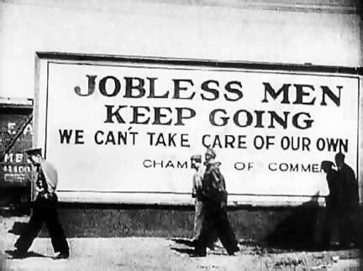
On Behalf of the Poor: Steinbeck’s contemporaries

Slide 2
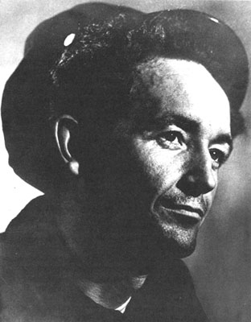
Woody Guthrie
Born 1912
Named after President Woodrow Wilson
Family lost all in the Depression
Traveled to California
Experienced scorn/ prejudice of the wealthy

Slide 3
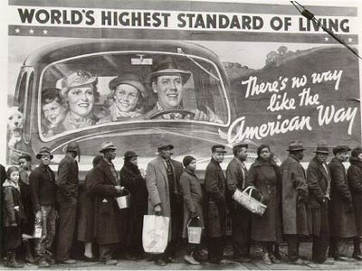
Like Steinbeck
Saw the corruption of the system
Communist sympathizer
Socialist
Unionist

Slide 4
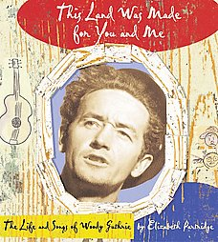
Wrote songs to protest
Wrote songs about class inequality
Most famous song: This Land is Your Land
Actually a protest song against “God Bless America”

Slide 5
“In the squares of the city, in the shadow of a steeple;
By the relief office, I’d seen my people
As they stood there hungry, I stood there asking,
Is this land made for you and me?”

Slide 6
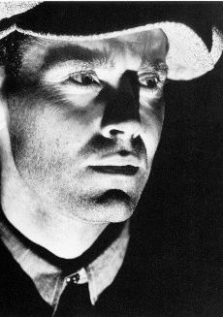
Other snappy tunes!
“I Ain’t Got No Home”
“Going Down the Road Feeling Bad”
“Tom Joad” (from the Grapes of Wrath by Steinbeck)

Slide 7
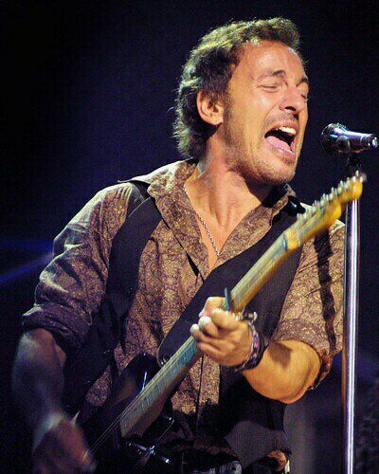
Influenced later singers
Pete Seeger (If I Had A Hammer- other Vietnam singers)
Bruce Springsteen; Ghost of Tom Joad
John (Cougar) Mellenkamp: Farm Aid
Rage Against the Machine: Tom Joad

Slide 8
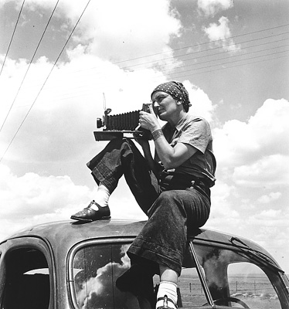
A Photographer of the people
Dorothea Lange
Worked for the Farm Security Administration to capture real life during the Great Depression

Slide 9
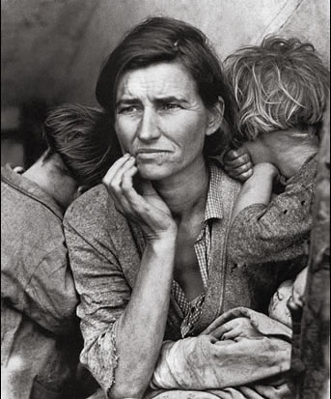
Iconic Photo
“Migrant Mother”
California, 1936
Woman’s name is Florence Owens Thompson
Actually 32 years old

Slide 10
“I saw and approached the hungry and desperate mother as if drawn by a magnet. I do not remember how I explained my presence or my camera to her, but I do remember she asked me no questions. I did not ask her name or history. She told me her age, that she was thirty-two.

Slide 11
“She said that they had been living on rotten vegetables from the surrounding fields and on birds the children had killed. She had just sold the tires from her car to buy food. There she sat in her lean-to tent with her children huddled around her, and seemed to know that my pictures might help her, and so she helped me. There was a sort of equality about it.”

Slide 12
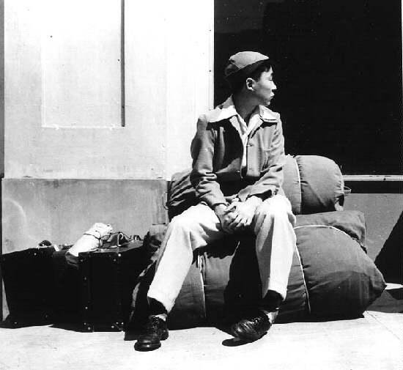
Later work
In the 1940’s went on to capture life in Japanese internment camps during WWII and other oppressed groups

